Slide 1
Project 1: Jeopardy
Jeopardy
Susana Espino & Demari Freeman

Slide 2
Statement of Problem
Project Description: Created a website that allows a user to create an account, login and play the popular game Jeopardy. Players can a choose a question from a selection of topics and difficulties and gain money by answering them.
Process: Uses cookies to save login information and sessions to save game progress and score to the leaderboard.
Goal: Once done with the game, the user can go back to the homepage to check their score.

Slide 3
Responsibilities
One sentence description of project: : Create a website that logins a user and allows them to play a video game.
Susana (Leader)
Leader. In charge of meeting group deadlines.
Main Coder
Designer
Demari
Coder.
In charge of the signin/signup page
Implemented the use of cookies

Slide 4
Requirements
HTML, CSS, PHP | Primary languages that were implemented while creating our game.
CSS CONCEPTS (TRANSFORMATIONS/ TRANSITIONS. | Animations that were used to enhance the look of the website
Cookies/Sessions | Used to remember login information
Form Processing | Allows PHP to interact with HTML and CSS
Logins | Allows user to make an account and then login again once they’re done playing.
:

Slide 5
Breakdown of Work
1
Step 1
4
Step 4
We brainstormed ideas and ultimately deciding on a jeopardy game.
Susana worked on the game while Demari worked on the other pages.
Step 2
Step 5
2
5
We first drew out the basic layout of the pages.
Tested out initial pages and troubleshoot any problems we found.
3
Step 3
6
Step 6
Next we decided to code the html and CSS of the login and homepages.
We finished our project and made our presentation.

Slide 6
Scrum Framework
Jeopardy
Scrum allowed us to evenly divide the workload by having Susana work on the game, and Demari work on the login pages and presentation
We both met up on tuesdays and thursdays in order to work on the project.
We ran into some errors getting php to work and run for the both of us early on, but we figured it out.

Slide 7
Program Flow Diagram
First Users go the login page.
If they don’t have an account, they must go to the sign-up page and make one.
Once you login, you enter the homepage.
From the homepage, you can access either the game or the leaderboard.
Login Page
Homepage
Sign-up Page
Actual Game
Leaderboard

Slide 8
File Descriptions
Index.php
login-submit.php
First initial page
Allows user to login and save information
Links to sign up page if user doesn’t have an account
Median between the login page and game homepage

Slide 9
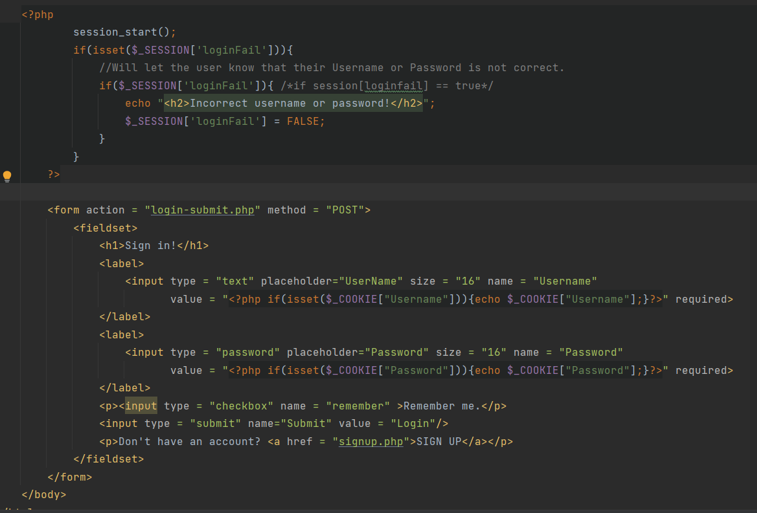
index.php
Jeopardy

Slide 10
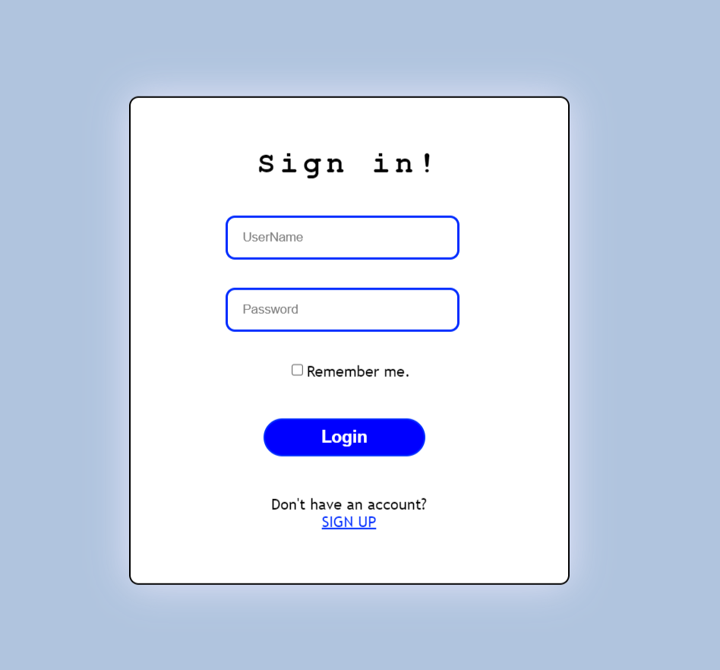
Login Page Output
Jeopardy

Slide 11
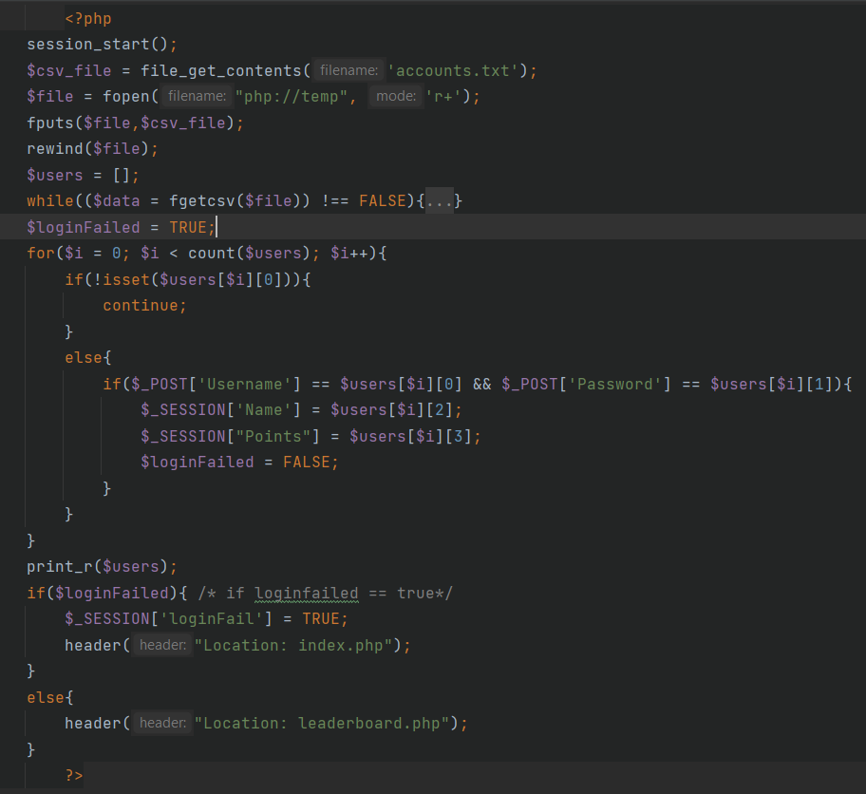
login-submit.php
Jeopardy

Slide 12
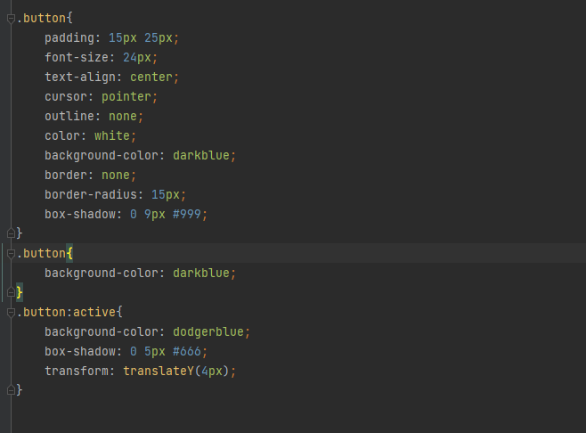
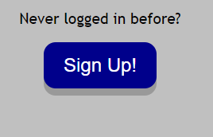
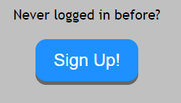
Animations
Jeopardy

Slide 13
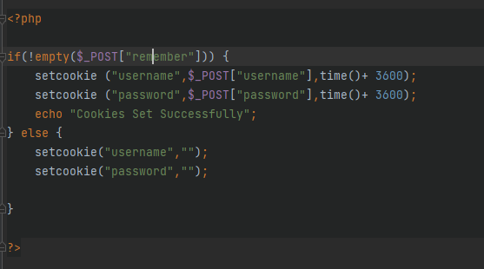
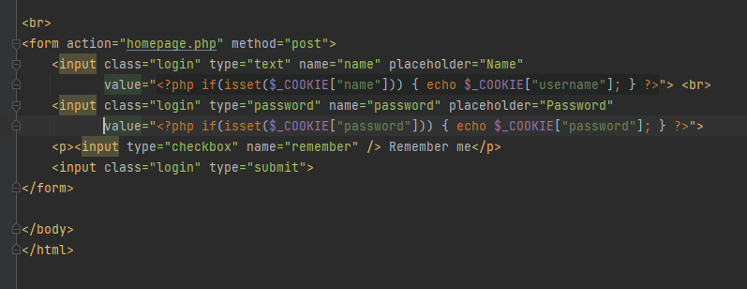
Cookies
Jeopardy

Slide 14
File Descriptions
signup.php
signup-submit.php
Allows user to create a new account
Links back to login page once finished
Adds new login information to a text file and saves it.

Slide 15
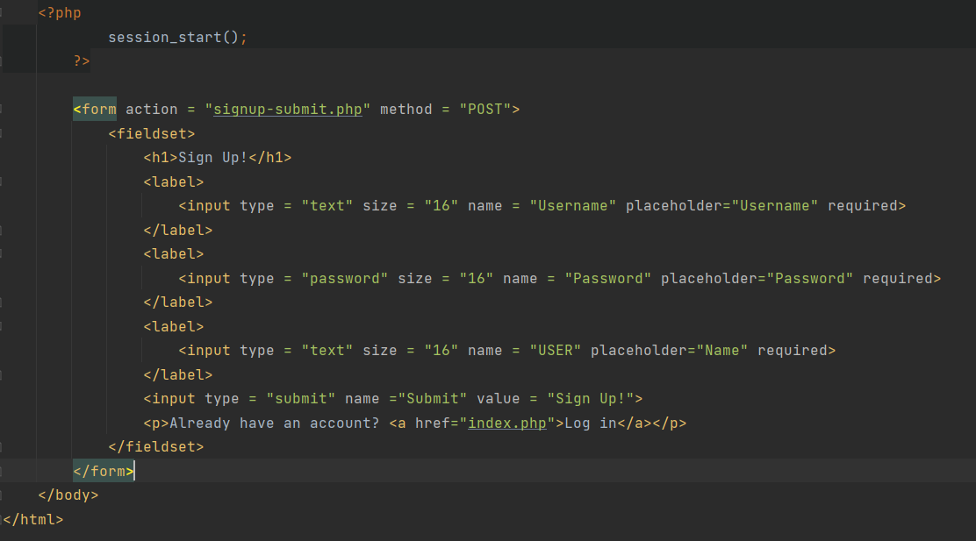
signup.php
Jeopardy

Slide 16
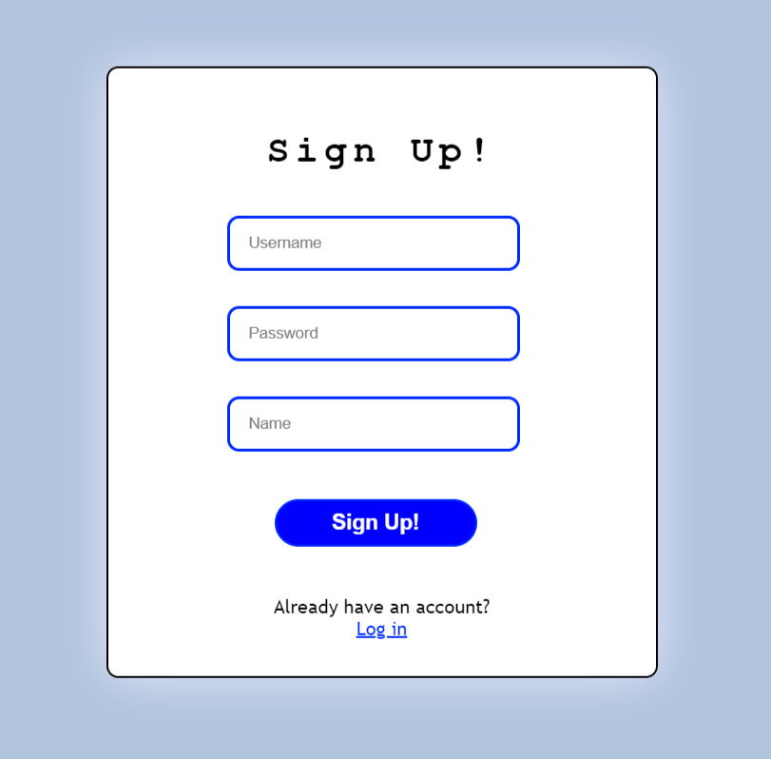
Signup.php Output
Jeopardy

Slide 17
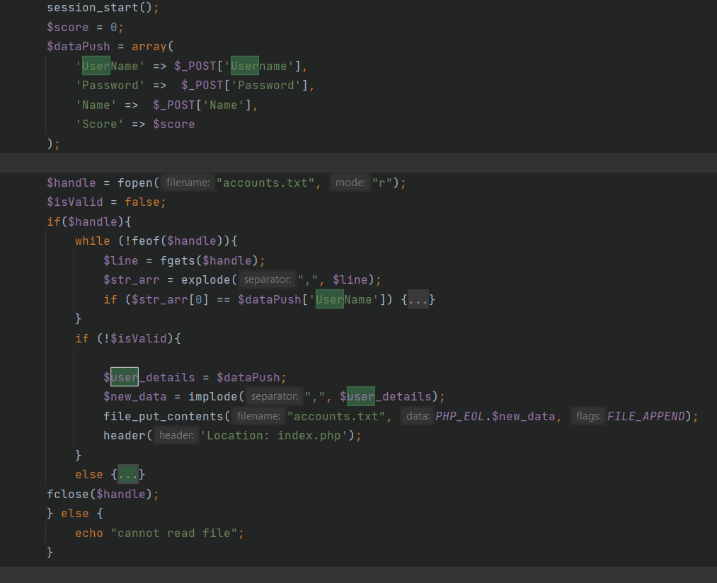
signup-submit.php
Jeopardy

Slide 18
File Descriptions
board.php
questionScreen.php
leaderboard.php
Page for the game board
Let’s user pick a question topic and difficulty
Displays question that the user chose
Can answer the question by choosing from the four available choices
Main Homepage
Shows leaderboard for players and their highscores
Allows you to start the game

Slide 19
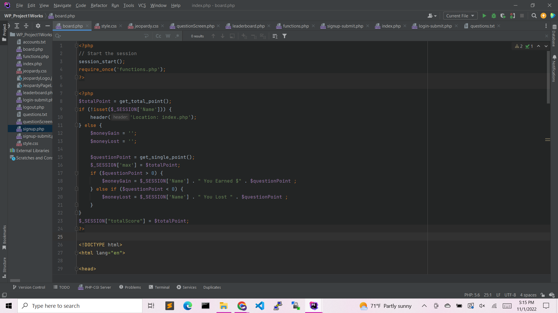
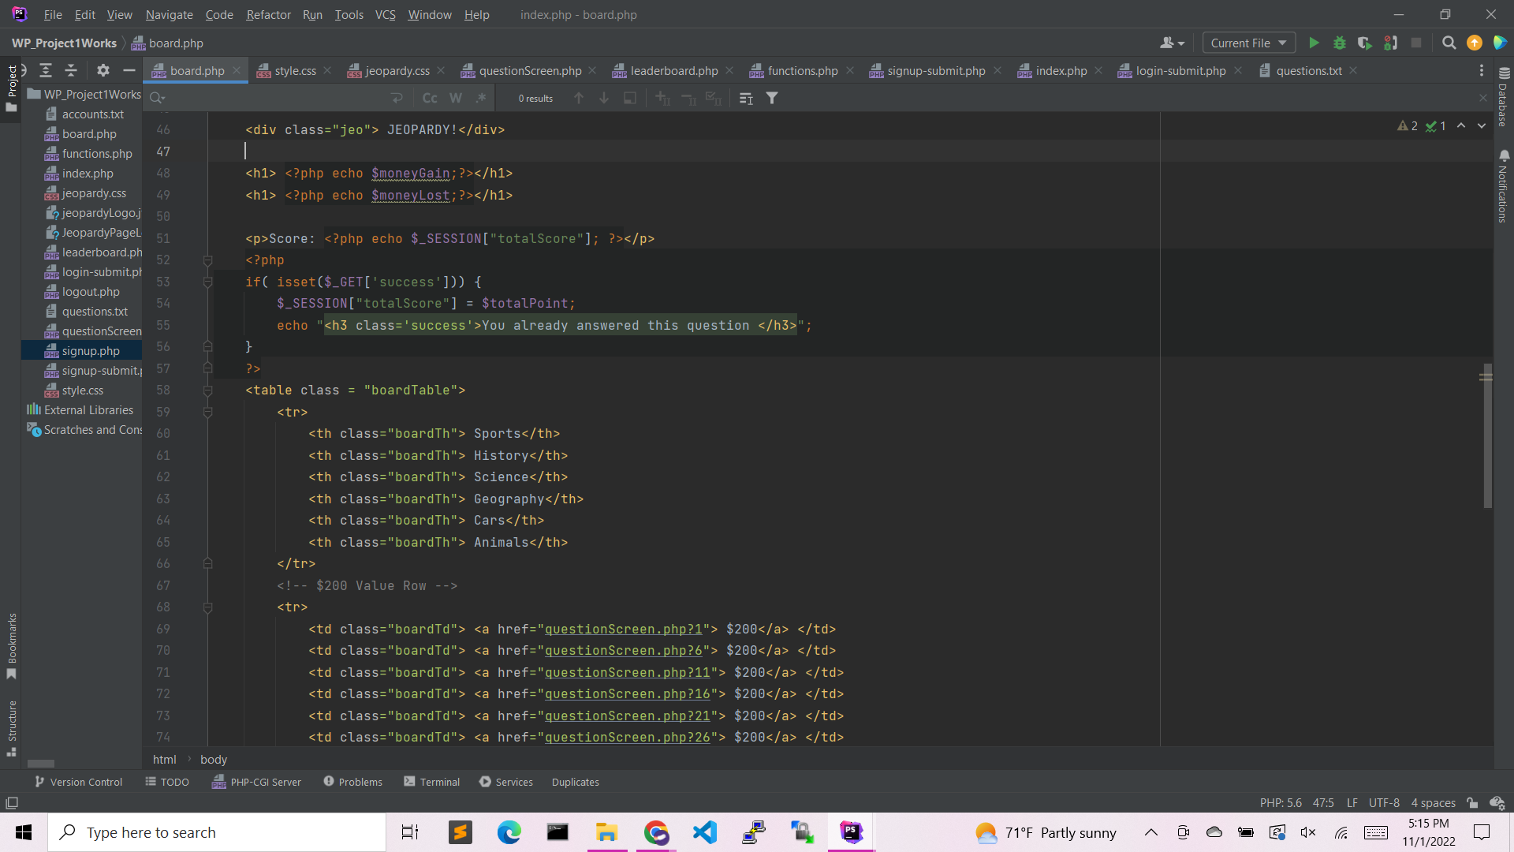
board.php
Jeopardy

Slide 20
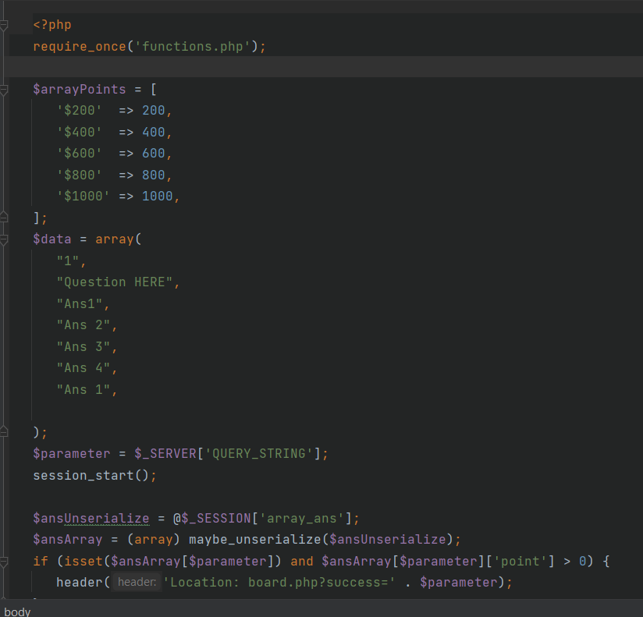
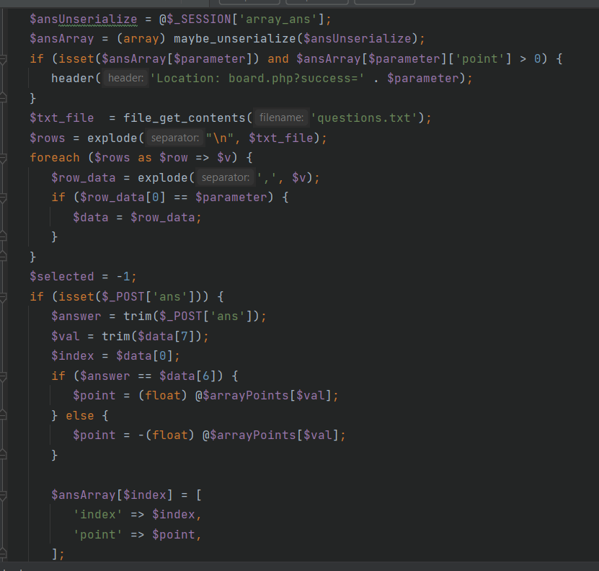
questionScreen.php
Jeopardy

Slide 21
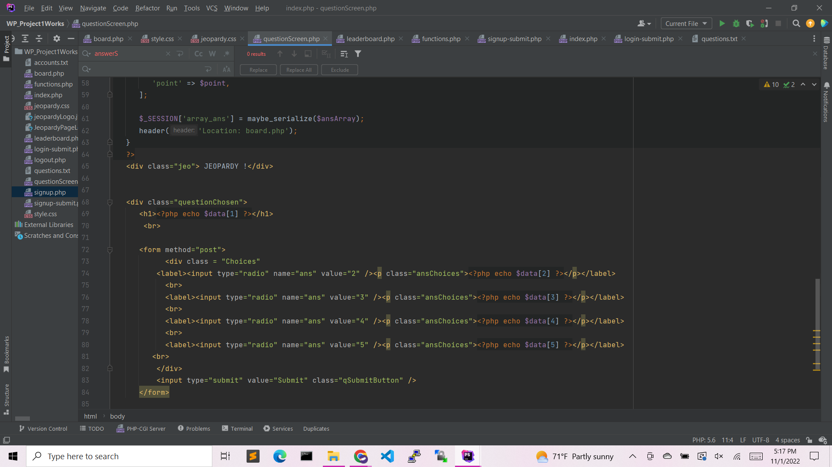
questionScreen.php
Jeopardy

Slide 22
leaderboard.php
Jeopardy

Slide 23
Demo link:
https://codd.cs.gsu.edu/~sespinogarcia1/WP/PW/1/index.php

Slide 24
End of Presentation

